Slide 1


Purwadhika School
OPTIMIZING PROFITABILITY
AND DISCOUNT STRATEGY
USING RETAIL BUSINESS ANALYTICS DATA
Dea dan Lauzia
Tim Assignment 5

Slide 2


LISTS OF
CONTENT
Problem & Objective
Data Overview, Findings & Validation
Simulation
Recommendation
optimizing profitability and discount strategy
using retail business analytics data - Dea & Lauzia

Slide 3
PROBLEM AND OBJECTIVITIES
PROJECT OVERVIEW
This project aims to analyze business performance using three key variables: Sales, Cost, Profit.
The analysis focuses on understanding how revenue is generated, how sales and cost impact profitability, and which areas of the business are most efficient.
By exploring patterns, distributions, and relationships between variables, this project provides insights to support better business decision-making.
OBJECTIVITIES
The main objectives of this analysis are:
- Identify key drivers of profitability
- Evaluate impact of discount and cost on margin
- Validate whether category and region influence profit
- Test multiple strategies through simulation
- Provide data-driven business recommendations
Halaman 3 dari 13
optimizing profitability and discount strategy
using retail business analytics data - Dea & Lauzia

Slide 4
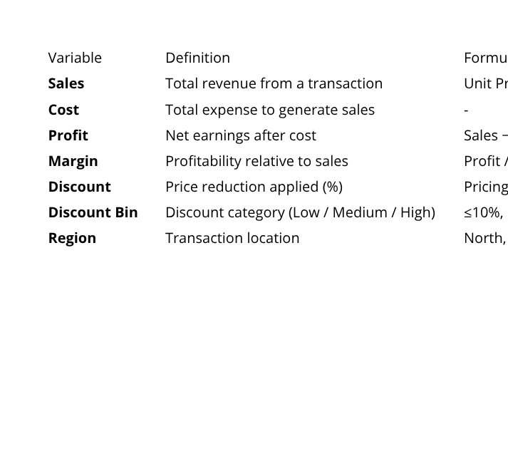
PROBLEM AND OBJECTIVITIES
VARIABLE DEFINITION
This analysis focuses on understanding the factors affecting profitability (margin). The key variables used in this analysis are:
EXPECTED INSIGHT
Whether higher sales always lead to higher profit, or if margin efficiency plays a more critical role
Whether product categories and regions significantly influence profitability, or if profit is driven by transaction-level dynamics
The extent to which discount impacts margin and reduces profitability
How cost contributes to inefficiency alongside discount
The effectiveness of different discount strategies in improving profit through simulation
These insights will help identify opportunities to improve profitability and operational efficiency.
Halaman 4 dari 13
optimizing profitability and discount strategy
using retail business analytics data - Dea & Lauzia

Slide 5
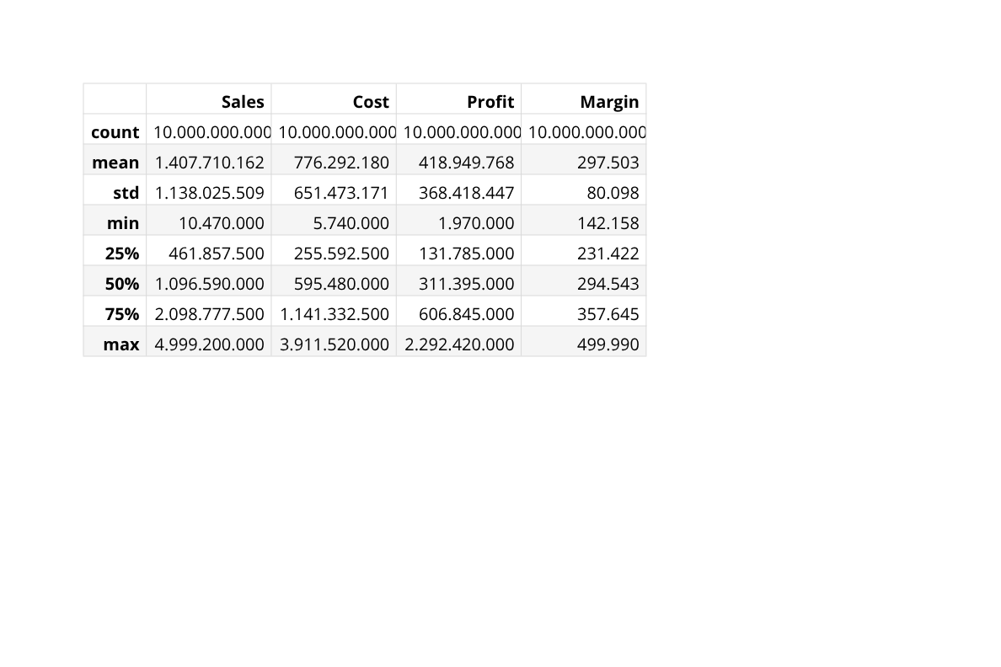
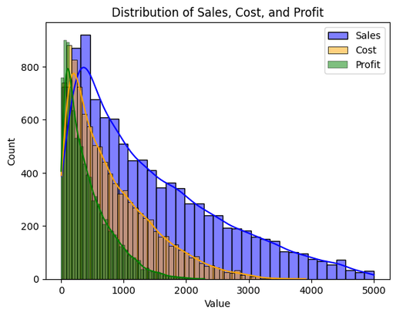
DATA OVERVIEW
SALES, COST, DAN PROFIT OVERVIEW
The average profit is 418.9, or approximately a 30% margin of sales, which is still relatively healthy but not yet optimal.
The median profit is 311.395, which is lower than the mean profit of 418.9, suggesting that most transactions generate profit below the average. It can be concluded that inefficiencies exist in a portion of the transactions.
- The distribution of sales, cost, and profit is right-skewed, indicating that most transactions are small, with a few high-value transactions.
- Sales values are significantly higher than cost and profit, confirming expected business structure.
- Profit distribution is more concentrated at lower values, suggesting relatively low profit margins.
- The presence of high sales values does not necessarily correspond to equally high profit, indicating potential inefficiencies or high costs.
- Overall, the business appears to rely on volume rather than high-margin transactions.
Halaman 5 dari 13
optimizing profitability and discount strategy
using retail business analytics data - Dea & Lauzia

Slide 6
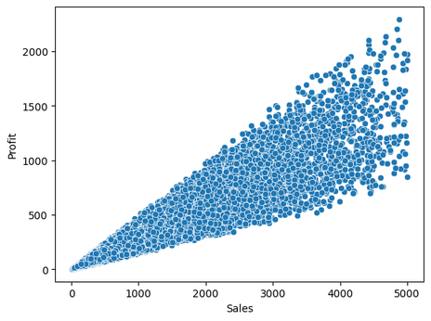
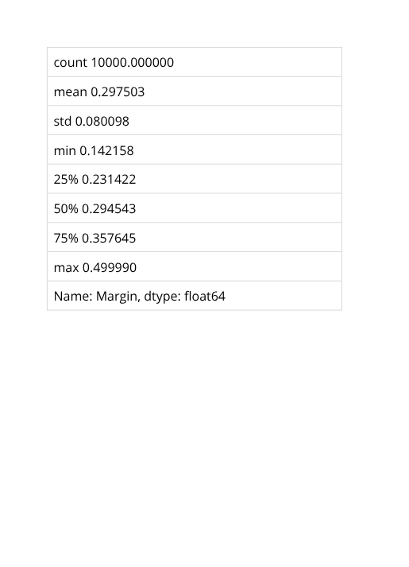
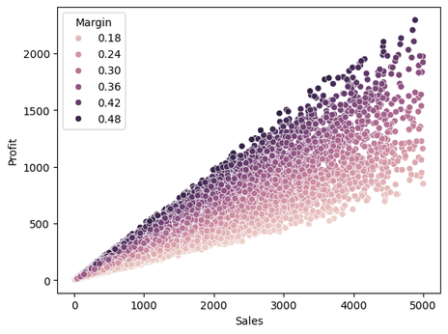
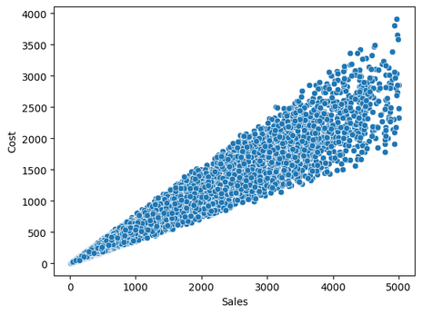
DATA OVERVIEW
SCATTERPLOT CORRELATION : SALES, PROFIT, COST, MARGIN
Sales vs Profit, higher sales tend to generate higher profit. However, this is not always efficient. The differences in profit are driven by variations in margin.
The average margin is around 30%, meaning each transaction generates approximately 30% profit from sales. The margin varies quite widely (14%–50%), indicating significant variation across transactions. Therefore, although the average margin is relatively good (~30%), there are variations between transactions that suggest inefficiencies at certain levels.
Profit differences are not driven solely by sales, but also by margin. This is indicated by the darker-colored upper area representing high margins, while the lighter-colored lower area represents low margins. Therefore, it is necessary to identify the causes of low margins, whether they are related to product categories or other factors.
Although cost generally increases with sales, there is significant variation in cost levels for similar sales values. This indicates inconsistency in cost efficiency across transactions.
Conclusion: Visually, sales, profit, cost, and margin are interrelated.
Halaman 6 dari 13
optimizing profitability and discount strategy
using retail business analytics data - Dea & Lauzia

Slide 7
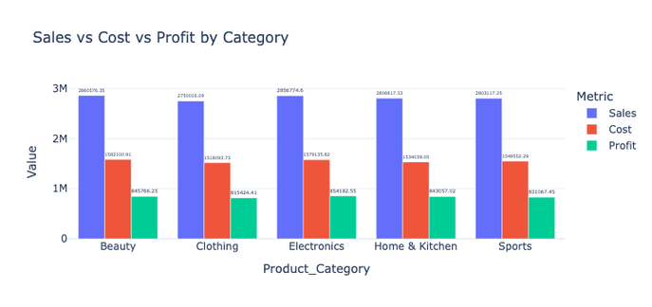

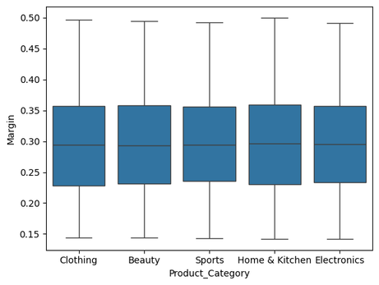
DATA OVERVIEW
SALES, COST, AND PROFIT BY CATEGORY
- Sales performance is relatively consistent across all product categories, indicating a well-balanced revenue distribution.
- However, profitability varies significantly, suggesting differences in cost efficiency.
- Electronics stands out as the most profitable category, demonstrating strong efficiency and high margin.
- Clothing shows relatively lower profit despite strong sales, indicating potential inefficiencies or higher cost structure.
- Overall, profit differences are driven more by cost variation than sales volume.
Business Recommendations - Focus on expanding high-margin categories such as Electronics
Based on the average margin, the Electronics category has the highest margin, while Clothing has the lowest. The difference is very small, so it can be concluded that all categories have relatively similar margins. This means that product categories do not significantly differentiate margin performance and are generally consistent. Therefore, differences in profit are likely driven by individual transaction factors such as pricing, discounts, or cost variability.
Visually, the margin distribution across product categories is nearly identical (in terms of mean and variance), indicating that the source of variation lies within categories.
Conclusion: Product category is not the cause of inefficiency.
The next step is to identify the factors driving inefficiency.
These factors exist at the individual transaction level, such as discounts, pricing, and cost.
Halaman 7 dari 13
optimizing profitability and discount strategy
using retail business analytics data - Dea & Lauzia

Slide 8
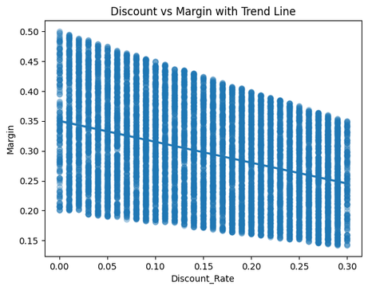
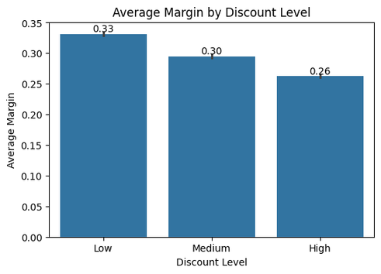
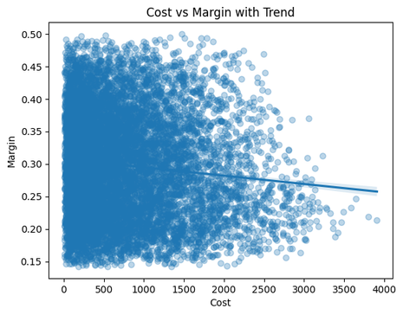
DATA OVERVIEW
DISCOUNT OVERVIEW
Based on the scatterplot of discount rate and margin, the downward trend line indicates that discount has an effect on margin.
The bar chart of average margin by discount level, it is observed that the higher the discount rate, the lower the margin. The margin decreases by about 20% relative to the baseline when moving from low to high discount levels. This 20% is calculated from the difference between the average margin at low and high discount levels (0.07) divided by the average margin at the low discount level (0.33), resulting in 20%.
Therefore, discounts are identified as a key driver of inefficiency at the transaction level.
The points are widely dispersed with a slight downward trend as cost increases, indicating that higher costs tend to reduce profitability. However, this relationship is relatively weak, suggesting that cost does not strongly explain inefficiency.
Conclusion: Visually, sales, profit, cost, and margin are interrelated.
Halaman 8 dari 13
optimizing profitability and discount strategy
using retail business analytics data - Dea & Lauzia

Slide 9
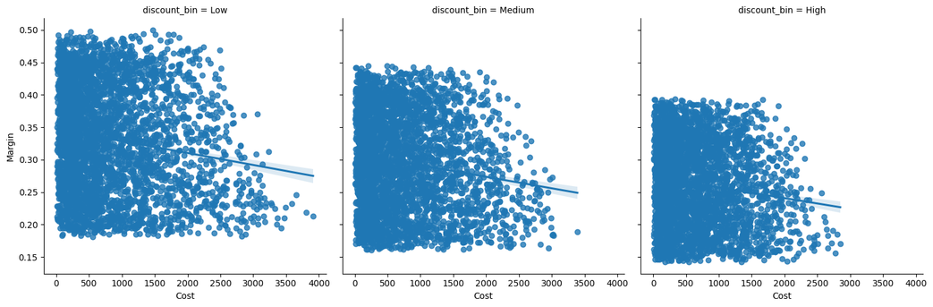
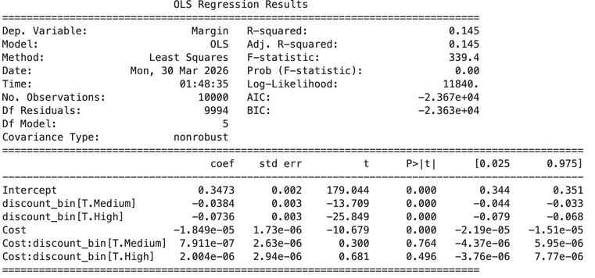
DATA OVERVIEW
MARGIN AND COST BY DISCOUNT
There are three plots: low discount, medium discount, and high discount. In all three plots, the margin trend line decreases as cost increases, indicating that cost affects margin at all discount levels.
Visually, the slope differs across plots: the slope in the low discount plot declines slightly, the medium discount plot declines more, and the high discount plot shows the steepest decline. This means that as the discount increases, the negative effect of cost on margin becomes stronger.
Medium discount, high discount, and cost have a significant effect on margin.
Conclusion: Visually and statistically, medium and high discount factors have a significant and substantial impact on margin, while cost has a significant but relatively small effect on margin.
Halaman 9 dari 13
optimizing profitability and discount strategy
using retail business analytics data - Dea & Lauzia

Slide 10
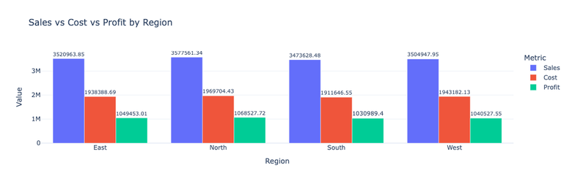
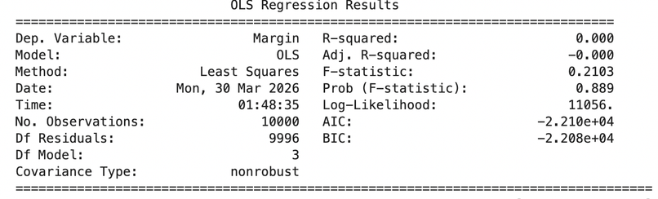
DATA OVERVIEW
REGION OVERVIEW
Based on the table/chart, all regions generate relatively similar levels of sales, cost, and profit. The North region has the highest sales and profit, followed by East and West, while the South region shows slightly lower performance compared to the others.
However, the differences across regions are relatively small, indicating that performance is fairly consistent geographically. This suggests that regional differences are more likely driven by transaction volume rather than operational efficiency. This indication still needs to be validated through inferential statistical testing.
Based on the linear regression output, the regional variable does not have a significant effect on efficiency or margin, as indicated by the F-statistic value (0.2103 > 0.05). This is further supported by the R-squared value of 0.00, meaning that the region variable explains 0% of the variation in margin, indicating no margin differences across regions.
Conclusion: Visually, descriptive statistics and inferential statistics have confirmed that region does not have a significant effect on margin.
Halaman 10 dari 13
optimizing profitability and discount strategy
using retail business analytics data - Dea & Lauzia

Slide 11
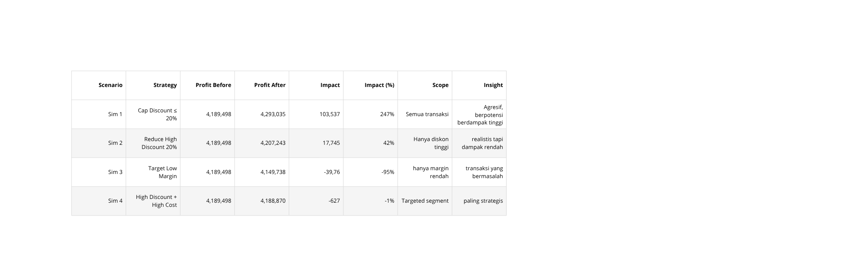
SIMULATION
Based on simulations 1, 2, 3, and 4, it can be seen that simulations 1 and 2 are the most likely to generate profit.
Although reducing discounts in simulation 1 can increase profit, it is very difficult to implement. Simulation 2 is more feasible to apply, even though it generates lower profit compared to simulation 1.
Halaman 11 dari 13
optimizing profitability and discount strategy
using retail business analytics data - Dea & Lauzia

Slide 12
RECOMMENDATION
From the analysis, profit is not influenced by category or region, but by margin at the transaction level, where discount has the greatest impact.
However, the simulation results show that managing discounts alone is not sufficient to significantly improve profit. Therefore, a more effective short-term strategy is to gradually reduce high discounts, while the long-term recommendation is to combine discount management with cost efficiency.
Halaman 12 dari 13
optimizing profitability and discount strategy
using retail business analytics data - Dea & Lauzia

Slide 13
THANK YOU
Halaman 13 dari 13

